Slide 1
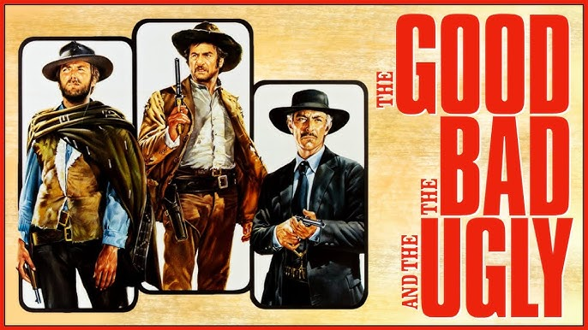
Science: The Good, the Bad, and the Ugly
Eric Prebys
Professor, Dept. of Physics and Astronomy
Director, Crocker Nuclear Laboratory

Slide 2
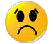
My Background
1984: BS in Engineering Physics, University of Arizona
Got a job in an HEP group after being fired from a gas station.
1984-1990: Grad Student, University of Rochester
PhD topic: Direct Photon Production in Hadronic Interactions
1990-1992: CERN Fellow, CERN
Studied e+e- reactions on the OPAL Experiment at LEP
1992-2001: Postdoc and Assistant Professor, Princeton U.
GEM Experiment at the Superconducting Super Collider
Belle CP Violation Experiment at KEK, Japan
Nonlinear QED in E-144 Experiment at SLAC
2001-2017: Scientist, Fermilab
MiniBooNE short baseline neutrino oscillation experiment
Proton Source Department Head
Director of LHC Accelerator Research Program (LARP)
Mu2e rare muon conversion experiment
Created Lee Teng Internship and ran it for 10 years
2017-present, Professor, UC Davis
Mu2e
Director, Crocker Nuclear Laboratory (cyclotron)
Experimental HEP
Accelerator Physics and HEP
Nuclear Physics
Medical Physics

Slide 3
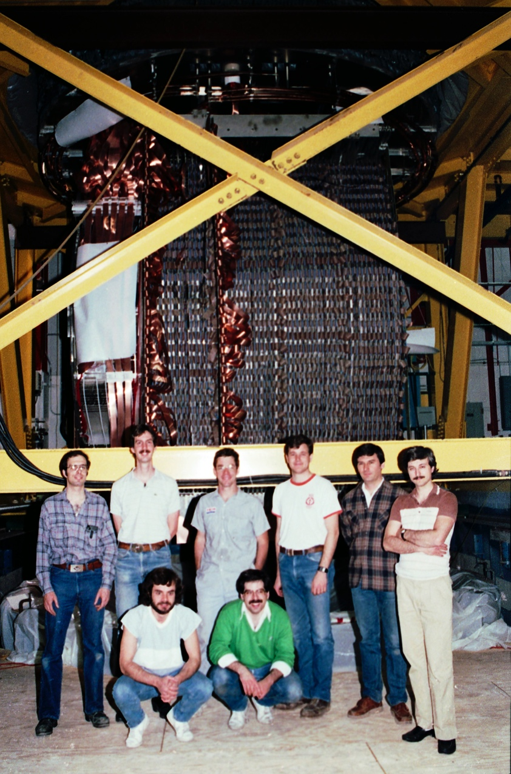
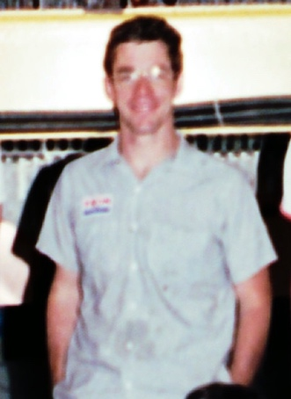
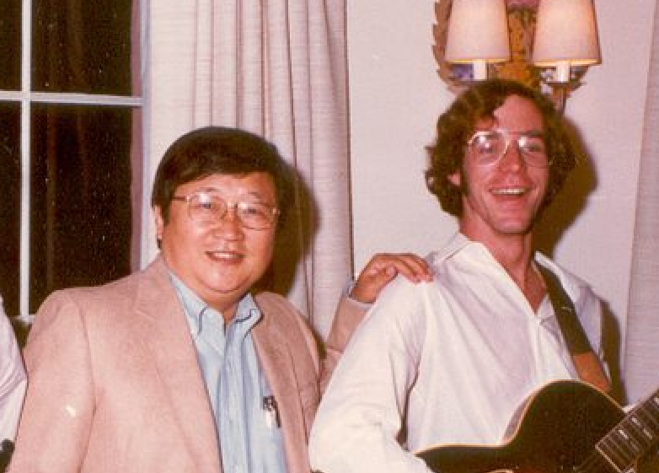
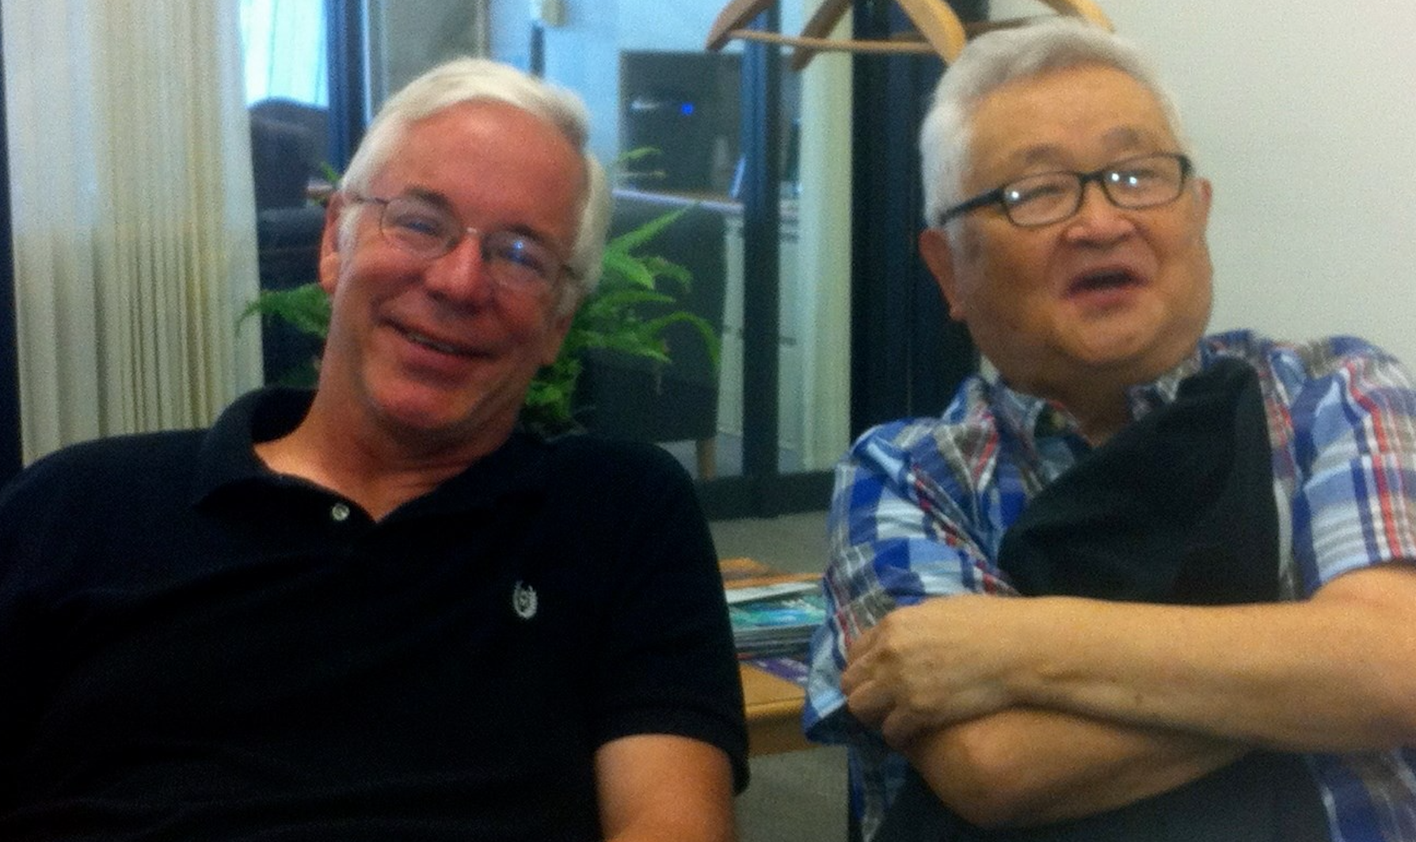
“Buck’s River Road Exxon”
Me
Kwan Lai, the guy that hired me
Fermilab E-706 Rochester Group
~1987
Then
Recent

Slide 4
Why I’m Teaching This Course
I’ve always been interested in outreach.
I’ve always been frustrated with the level of ignorance about (and sometimes hostility toward) science.
Studying bad science is often a good way to help understand good science.
I would not recommend this in other fields, e.g. brain surgery.
Like many in science, I take public money, so I feel I have a responsibility to advise others of questionable results reported in the popular media, or even in scientific journals
i.e. give your opinion whether they want it or not

Slide 5
Goals of this Course
Give students an understanding of what is and isn’t science.
Gain a basic understanding of errors and significance!
Misunderstanding the significance of results is one of the biggest problems in the media and the public
Learn some of the warning signs of bad science.
Good science turning bad
Good science that’s incorrectly reported.
Deliberate fraud
Learn some ways to improve your understanding
Accept that you can be fooled.

Slide 6
Lectures
9/24: Introduction and Goals
10/1 The Good: Enlightened by Light
10/8: Lies, Damned Lies, and Statistics
10/15: Energy: No Such Thing as a Free Lunch
10/22: Bad Medicine
10/29: Criminally Bad Forensic Science
11/5: “Science” or Just Racism?
11/12: Satanic Panic and other Dangerously Bad Science
11/19: Spooky Bad Paranormal Studies
11/26: The Media and Science: Friends or Foes?
12/3: Science and Politics are a Dangerous Mixture

Slide 7
Grading
This course will be graded Pass/Fail
I don’t feel obligated to fail anyone, but..
It’s an interactive course, so attendance is mandatory
No more than two unexcused absences to pass!
In lieu of a midterm, you will write a short paper going into depth on one example of a erroneous scientific result.
The in class final will present a number of experimental scenarios, and you’ll be asked to identify potential sources of bias in the protocols and/or suggest improvements.
Grading
Class participation: 40%
Midterm paper: 30%
Final: 30%

Slide 8
Scope of The Course
For the most part, we’re going to restrict ourselves to things that bear some resemblance to “good” science.
In many cases, things that were taken very seriously by the scientific community.
Except for the occasional comic relief, we’ll steer clear of truly crazy stuff
Flat Earth
Moon Landing Hoax
Hollow Earth
Velikovsky

Slide 9
Definitions…
The Good:
Make observations and measurements
Develop a model to explain these with the fewest possible variables and assumptions (must also be consistent with all existing data).
Investigate the predictions and consequences of this model.
The Bad
Like good science in principle, but lack of rigor and/or bias (intentional or unintentional) lead to erroneous conclusions.
Whether accidental or intentional, it can have grave consequences.
The Ugly
Propose theories or claim experimental results which cannot possibly be reconciled with significant body of real world data.
Can be the product of profound ignorance or deliberate fraud.
Aka “Crackpot Science”, “Voodoo Science”, etc
We’ll spend most of our time on this

Slide 10
How Scientific Discovery Works
Broadly speaking, science advances in two ways:
Experiment driven:
A completely unexpected and surprising observation is made.
A new theory or theoretical modification must be proposed to explain it
Examples:
Superconductivity
Parity and charge-parity violation
Mossbauer Effect
The new theory then becomes the input for…
Theory driven:
A theory is proposed that is consistent with current empirical observations
Additional experiments are carried out to either confirm or refute the additional predictions of the the theory.
Examples:
Failed
Ether wind (Michelson-Morley Experiment)
Cold fusion (MUCH more about this in a few lectures)
Successful:
Discovery of Neptune
Antimatter
Several quarks
W, Z, and Higgs particles

Slide 11
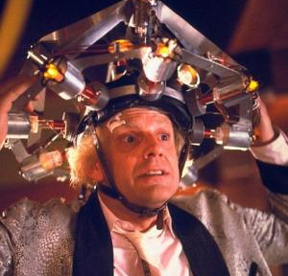

Science: Myth vs. Reality
Myth
Independent
Maverick
Makes lots of important discoveries in career
Results come quickly
Reality
Systematic and meticulous
Often work in large groups
Results take time!!
One significant discover y = Nobel Prize!
Society loves this…
… but benefits from this

Slide 12
Science vs. Technology
It's very important to make a distinction between “science” and “technology”
”Science” is how we learn the fundamental rules of nature
“Technology” is the application of these rules.
Science and technology are closely intertwined, but they are still distinct.
New science enables new technology
New technology gives us the tools to push the boundaries of science.
Although we live in a time of amazing technological advances, fundamental scientific advances are still few and far between.

Slide 13
Incorrect Results in Science
There have been cases of intentional fraud in science
Piltdown Man
Andrew Wakefield linking vaccines to autism (we’re still suffering from this)
Jaques Benveniste’s seeming confirmation of homeopathy (“water with memory”) was probably fraud by an overzealous lab tech.
but these are fairly rare (and usually involve things that are potentially profitable!)
On the other hand, there have been many cases of inaccurate results in science, based on some combination of sloppy analysis, experimental bias, wishful thinking, and occasionally willful self-deception.
or at least that’s how it starts (e.g. Cold Fusion)
Procedural remedies to mitigate these problems were fairly long in coming
For example, blind analyses were not standard in many fields of physics until the mid to late 1990s.

Slide 14
The Importance of Blinding
Even with the best intentions, people are susceptible to biases.
Knowing what “answer” we’re looking for might subtly affect the sort of things we look for in quality control and cross checks.
For example, if the model predicts a certain number of events in a signal region:
If I see fewer than that, I might be inclined to search for inefficiencies in my detector or analysis cuts.
If I see more than that, I might be more inclined to search for backgrounds or other false positives.
In reality, I could have both of these things and preferentially searching for one or the other could bias my result.
Blinding procedures in physics started to become common in the mid-1990s and have now become expected.
There would be little confidence in a discovery today that didn’t come from a blind analysis.

Slide 15
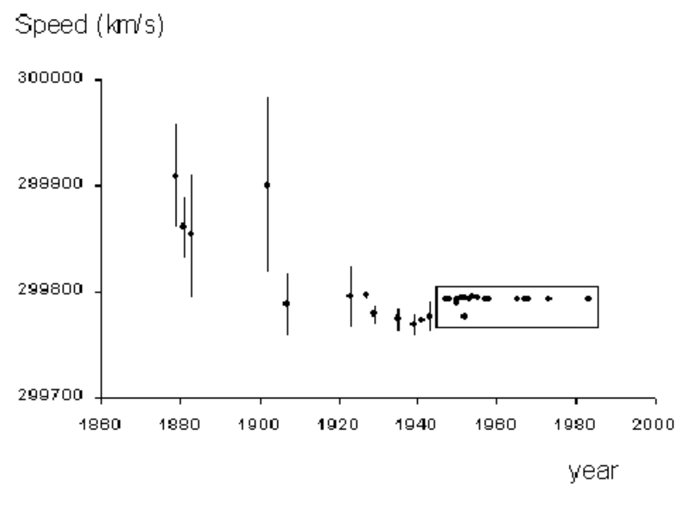
Evidence of Bias
Without blinding, results have a habit of tracking either predictions or previous results.
Example: speed of light
Big shifts driven by new, precision measurements

Slide 16
What does Double Blind Mean?
In experiments involving people, you have the possibility of bias both on the part of the researcher AND the subject.
For example, in a drug trail:
The patient should not know whether they are getting the drug or the placebo.
The person evaluating the effect of the drug should also not know.
The information as to who got the drug and who got the placebo should only be released after the evaluation of the effects has been made.
Sometimes this is much harder than others.

Slide 17
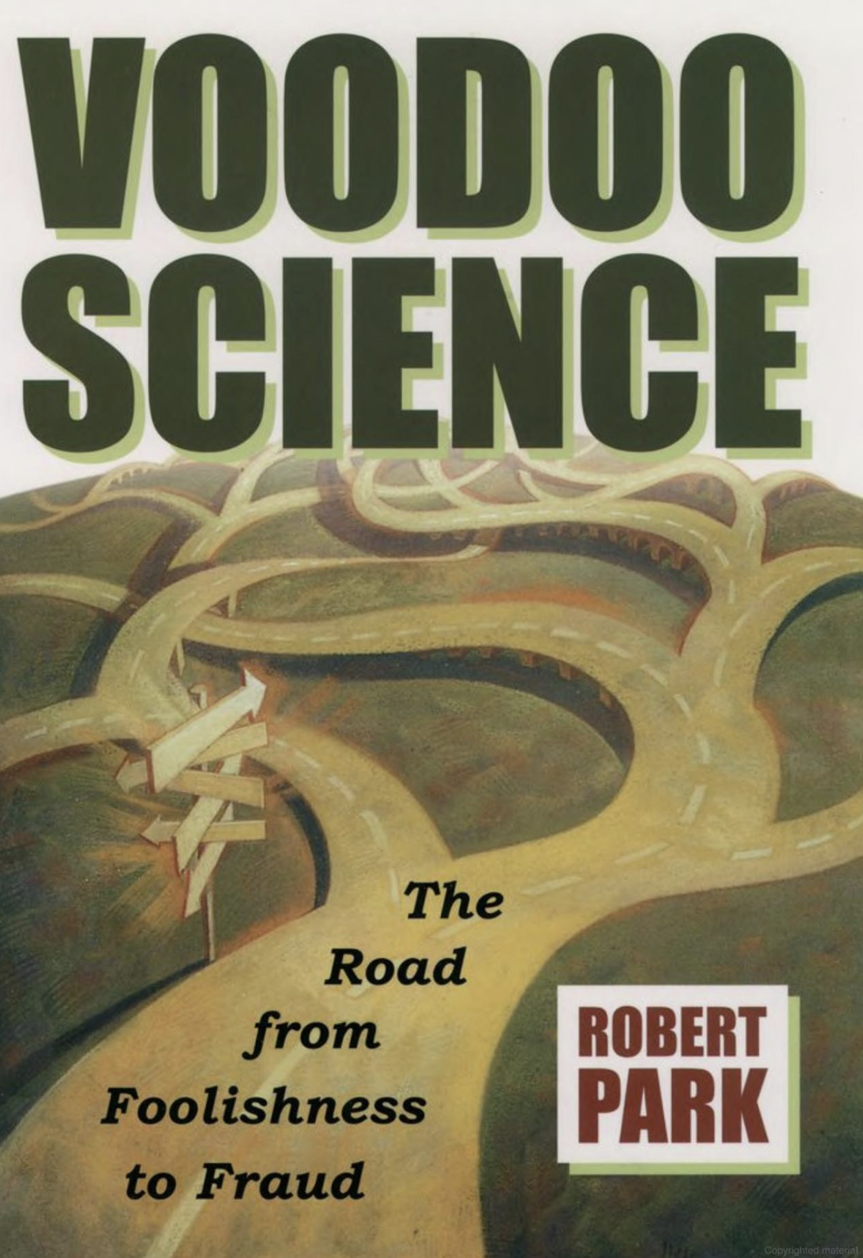
Course Text
Bob Park was a University of Maryland Professor to covered science and science policy in Washington DC for the APS for many years.
He published a weekly newsletter, which many of us were addicted to in the early days of the internet. It included the famous disclaimer
“These are not necessarily the views of the APS, but they should be.”
This book is a fantastic resource for understanding what is and isn’t science.
It’s also short, which I like in a book.

Slide 18
Bob’s Seven Indicators of Voodoo Science
The discoverer pitches the claim directly to the media.
The discoverer says that a powerful establishment is trying to suppress his or her work.
The scientific effect involved is always at the very limit of detection.
Evidence for a discovery is anecdotal.
The discoverer says a belief is credible because it has endured for centuries.
The discoverer has worked in isolation.
The discoverer must propose new laws of nature to explain an observation.
I’ll add an 8th:
Discovery relies on ”special skills” on the part of the observer, which brings us to…
We’ll see these again and again

Slide 19
Example: N-Rays
In 1903, French scientist René Blondot claimed that some type of ray emanating from an X-ray tube or other sources caused slight changes in brightness in a spark gap or flame.
The changes were very slight. You had to be “trained” to see them.
He called these rays “N-Rays” after the University of Nancy, where he worked.
In the next few years over 300 papers by 120 scientists confirmed the existence of N-rays and measured diffraction and scattering spectra off of different materials.
In 1904, American physicist Ron Wood visited Blondot’s lab. He surreptitiously removed the scattering target, but Blondot continued to “see” the diffraction spectrum.
The whole thing had been completely imaginary!

Slide 20
Other Good Texts…
Martin Gardner, "Fads and Fallacies in the Name of Science"
Similar to Park's Book, with more in-depth coverage of a limited number of topics.
Stephen J. Gould, "The Mismeasure of Man"
History of bad science in support of racism
Richard Harris, "Rigor Mortis: How Sloppy Science Creates Worthless Cures, Crushes Hope, and Wastes Billions"
A disturbing book about some of the serious issues in medical research
Ray Hyman, "The Illusive Quarry: A Scientific Appraisal of Psychical Research
An analysis of some of the sincere - but deeply flawed - paranormal research that went in the the late 20th century

Slide 21
Defense of "fringe" science
It’s important to distinguish ”crackpot science” from” fringe science”
“Fringe science” is science that involves measurements or theories which are extremely difficult to reconcile with the prevailing theoretical framework but are nevertheless not yet ruled out experimentally.
Fringe science is not only legitimate but vital.
Many accepted theories were once “fringe”
Plate tectonics
Theory of relativity
Quantum mechanics
Expanding universe
Some examples of current fringe experiments include
Search for tachyons
Gravitational mass of antimatter
Unfortunately, unless care is taken, fringe science can easily become crackpot science…

Slide 22
Some Things to Remember
The media love a story and are generally terrible at covering science.
ALWAYS read the original source.
More often that not, it bears little relation to the news story.
Be on the lookout for “weasel words”
e.g. “The data suggest” = “We needed to publish something even though we can’t draw a solid conclusion”.
The plural of “anecdote” is not “evidence”
Personal experience make good news stories, but there are of little value in determining causality.
Look for consistency
Example:
One study of powerlines found a weak correlation with leukemia and no correlation with brain tumors.
Another found a weak correlation with brain tumors and no correlation with leukemia
In fact, this weakened the statistical significance of BOTH, but it was reported as “data suggest powerlines cause leukemia AND brain tumors”.

Slide 23
Backup Slides

Slide 24
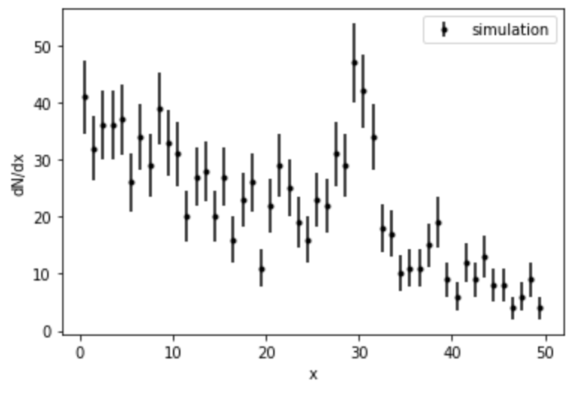
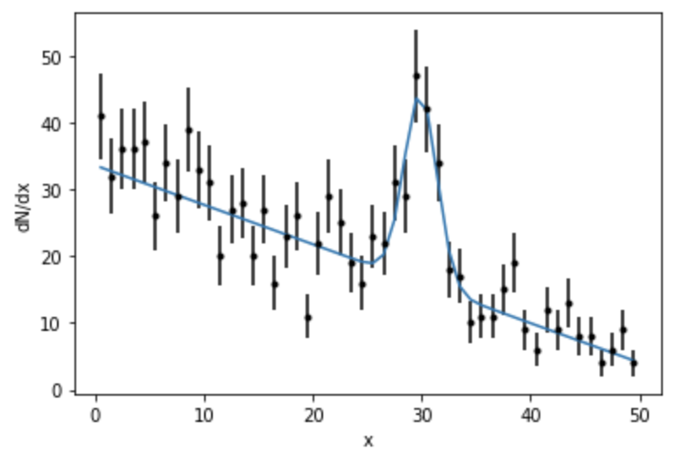
Blinding Techniques
It takes a lot of confidence to do a blind analysis!
You need to somehow gain confidence in your measurements without looking in the signal region
Sometimes it’s pretty easy.
To use our example from lecture, if I’m looking for a resonance on top of a spectrum, I simply exclude the region of the resonance and use the other events to estimate the background.
Once I’m confident in my understanding of my backgrounds and efficiencies, I ”open the box” (often with great ceremony) and do the final fit.
Then publish the result no matter what it is!

Slide 25
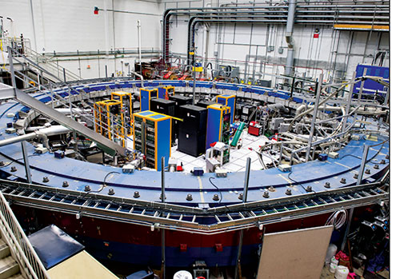
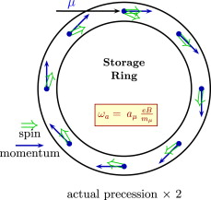
Another Easy Example: Muon g-2*
The “g-2” experiment at Fermilab looks for new physics by precisely measuring the precession of muons in a magnetic field.
*the blinding is easy. The experiment’s hard as hell!

Slide 26
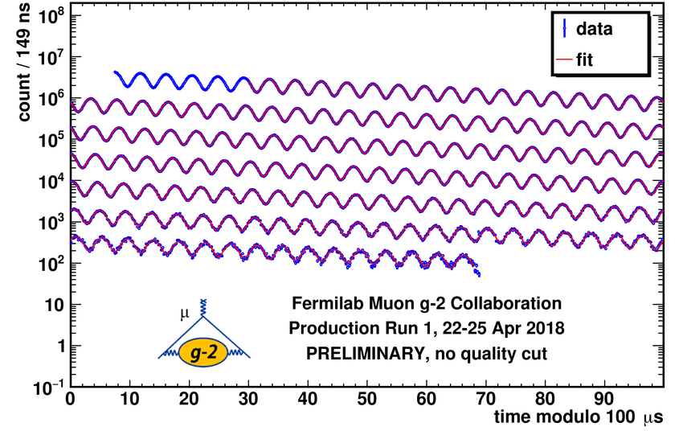
The result
To first order (g=2), the precession frequency is ” and as the revolution frequencies
Higher order corrections cause a “beating” that directly measures the difference (g-0)
The muons are highly polarized along their direction of motion when they enter the ring
As they decay to an electron and a neutrino, the electron is preferentially along the direction of spin.
The frequency of this plot is a direct measure of the anomalous moment.
How did they blind it?
The entire analysis was done using an arbitrary time unit.
The conversion factor to μs was kept “secret”, and not revealed until they had performed all quality control checks and were confident in their results.
Electron signals

Slide 27
Sometimes it’s Harder
In the Mu2e Experiment at Fermilab, the signal region is at the end of the background spectrum.
Also, once you’ve opened the box, how do you deal with additional data?
Determining the blinding procedures for an experiment are one of the most important parts of the analysis.
Statistically enhanced signal region. We want to be able to claim a signal with just a few
Can we really gain confidence in this background region by just looking at one side?

